Slide 1
Protection and Security
Type of misuse
  Accidental
  Intentional
Protection is to prevent either accidental or intentional misuse
Security is to prevent intentional misuse

Slide 2
Three Pieces to Security
Authentication – who user is
Authorization – who is allowed to do what
Enforcement – make sure people do only what they are supposed to do

Slide 3
Authentication
Common approach: passwords. Shared secret between two parities. Since only I know password, machine can assume it is me.
Problem 1: System must keep copy of secret, to check against passwords. What if malicious user gains access to this list of passwords?
  Encryption – transformation that is difficult to reverse without the right key.
  For example: UNIX /etc/passwd or Linux /etc/shadow file
  passwd -> one way transform -> encrypted passwd
  System stores only encrypted version, so ok even if someone reads the file!

Slide 4
Authentication (cont)
Problem 2: Passwords must be long and obscure
  Paradox: short passwords are easy to crack; long ones, people write down.
  Technology means we have to use longer passwds; UNIX initially required only undercase, 5 letter passwords
  How long for an exhaustive search? 26^5 = 10 million
    In 1975, 10 ms to check a passwd -> 1 day
    In 1992, 0.001ms to check a passwd -> 10 seconds
  Many people choose even simple passwords, such as English words

Slide 5
Authentication (cont)
Some Solutions for Problem 2
  Require more complete passwords. For example: 6 letter, with upper and lower and number and special:
  70^6 ~ 600 billion, or 6 days
  Make it take a long time to check each password. For example, delay every remote login attempt by 1 second
  Assign very long password.
Problem 3: Can you trust the encryption algorithm? Recent example: one thought to be safe, has a back door. If there is a back door, means you don’t need to do complete exhaustive search.

Slide 6
Security in Distributed Systems
Cryptography functions
  Symmetric-key (e.g., DES)
  Public key (e.g., RSA)
  Message digest (e.g., MD5)
Security services
  Confidentiality: preventing unauthorized release of information
  Integrity: making sure message has not been altered
  Authentication: verifying identity of the remote participant

Slide 7
Authorization
Authorization: who can do what
Access control matrix: formalization of all the permissions in the system
  Objects file1 file2 file3 …
  Users
  A rw r
  B rwx
  C r rwx
  …
Potentially huge # of users, operations, so impractical to store all of these.

Slide 8
Authorization (cont)
Access control list – store all permissions for all users with each object
  Still might be lots of users! UNIX addresses this by having each file stores: r, w, x for owner, group, world.
Capability list – each process, stores all objects the process has permission to touch
  Lots of capability systems built in the past; idea out of favor today. But page tables are an example.

Slide 9
Enforcement
Enforcer checks passwords, access control lists, etc.
Any bug in enforcer means: way for malicious user to gain ability to do anything.
  In UNIX, superuser has all the powers of the UNIX kernel – can do anything. Because of coarse-grained access control, lots of stuff has to run as superuser in order to work. If bug in any one of these programs, you’re hosed.

Slide 10
Paradox:
Make enforcer as small as possible
  Easier to make correct, but simple-minded protection model
Fancy protection – only minimal privilege necessary, hard to get right

Slide 11
State of the World in Security
Authentication – encryption
  But almost nobody encrypts!
Authorization – access control
  But many systems provide only very coarse-grained access control (ex: UNIX – means, need to turn off protection to enable sharing)
Enforcement – kernel mode
  Hard to write a million line program without bugs, and any bug is a potential security loophole.

Slide 12
Program Threats
Trojan Horse
  Code segment that misuses its environment
  Exploits mechanisms for allowing programs written by users to be executed by other users
  Spyware, pop-up browser windows, covert channels
Trap Door
  Specific user identifier or password that circumvents normal security procedures
  Could be included in a compiler
Logic Bomb
  Program that initiates a security incident under certain circumstances
Stack and Buffer Overflow
  Exploits a bug in a program (overflow either the stack or memory buffers)

Slide 13
C Program with Buffer-overflow Condition
#include <stdio.h>
#define BUFFER SIZE 256
int main(int argc, char *argv[])
{
char buffer[BUFFER SIZE];
if (argc < 2)
return -1;
else {
strcpy(buffer,argv[1]);
return 0;
}
}

Slide 14
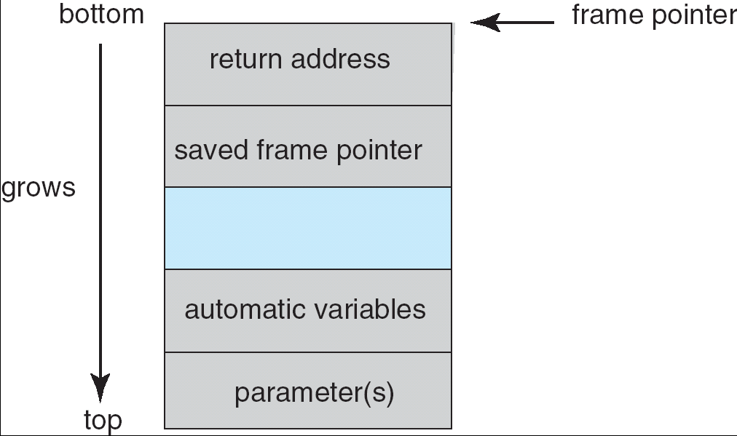
Layout of Typical Stack Frame

Slide 15
Modified Shell Code
#include <stdio.h>
int main(int argc, char *argv[])
{
execvp(‘‘\bin\sh’’,‘‘\bin\sh’’, NULL);
return 0;
}

Slide 16
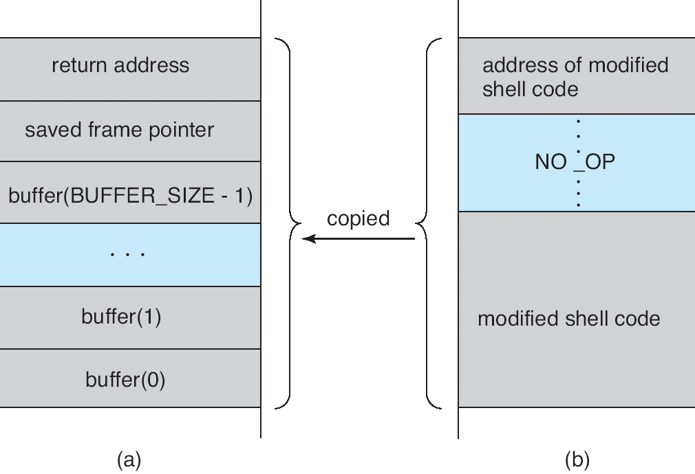
Hypothetical Stack Frame
Before attack
After attack

Slide 17
System and Network Threats
Worms – use spawn mechanism; standalone program
Internet worm
  Exploited UNIX networking features (remote access) and bugs in finger and sendmail programs
  Grappling hook program uploaded main worm program
Port scanning
  Automated attempt to connect to a range of ports on one or a range of IP addresses
Denial of Service
  Overload the targeted computer preventing it from doing any useful work
  Distributed denial-of-service (DDOS) come from multiple sites at once

Slide 18
The Internet Worm
Broke into thousands of computers over internet in 1988.
Consisted of two programs
  bootstrap to upload worm
  the worm itself
Worm first hid its existence
Next replicated itself on new machines

Slide 19
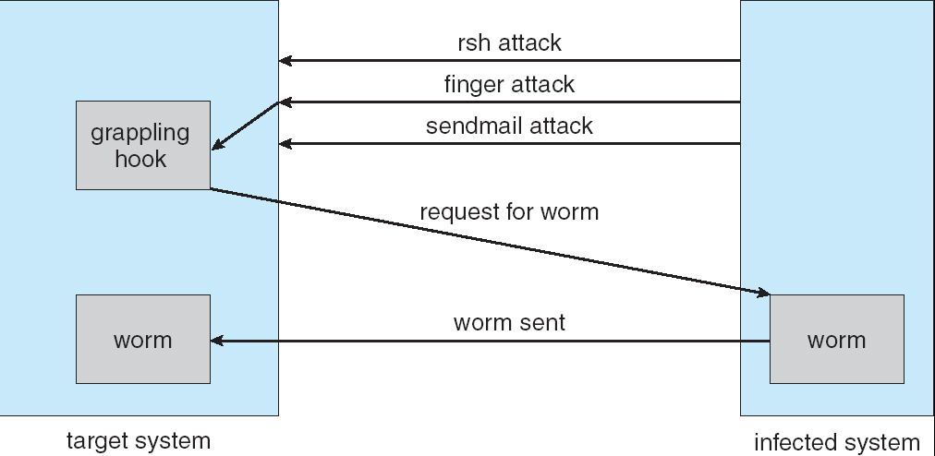
The Morris Internet Worm

Slide 20
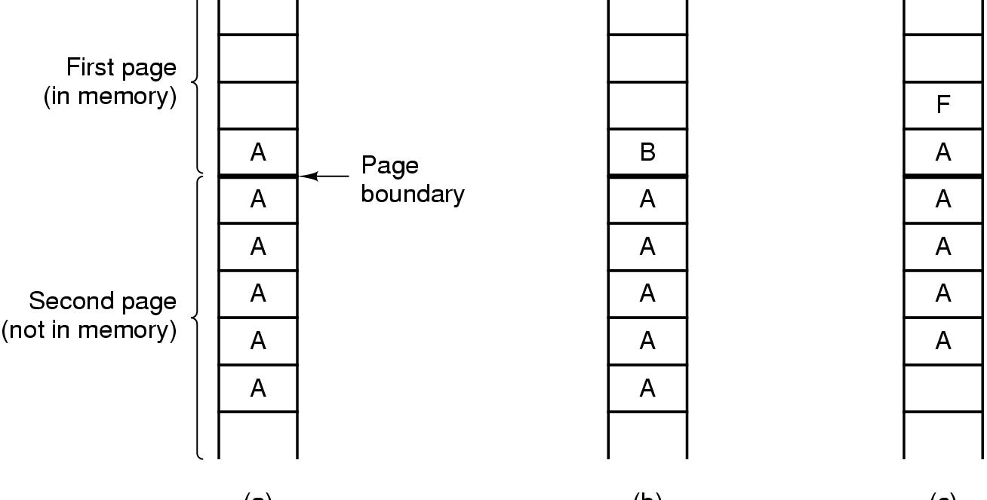
Famous Security Flaws
https://www.sjoerdlangkemper.nl/2016/11/01/tenex-password-bug/
(a)
(b)
(c)
The TENEX – password problem

Slide 21
The TENEX – password problem
Here’s the code for the password check:
for (i=0; i <8; i++)
if (userPassword[i] != realPassword[i])
go to error;
Looks innocuous, like you’d have to try all combination. 256^8
But! Tenex also used virtual memory, and it interact badly with the above code.
Key idea: force page faults at inopportune times:
  This made it possible to guess user passwords one character at a time

Slide 22
Thompson’s self-replicating program
Proposed by Ken Thompson in his Turing award lecture
Bury trojan horse in binaries, so no evidence in the source
Replicates itself to every UNIX system in the world, and even to new UNIX’s on new platforms. No visible sign
Gave Ken Thompson the ability to log into any UNIX system in the world.
Two step:
  Make it possible (easy)
  Hide it (tricky)

Slide 23
Step 1. Modify login.c
A: if (name ==“ken”)
don’t check password
login as root
Idea is: hide change, so no one can see it.
Step 2: Modify the C compiler
Instead of having the code in login, put it in the compiler:
B: if see trigger,
insert A into input stream
Whenever the compiler sees a trigger, put A into input stream of the compiler.
Now, don’t need A in login.c, just need the trigger.
Need to get rid of the problem in the compiler.

Slide 24
Step 3: Modify compiler to have:
  C: if see trigger2
  insert B + C into input stream
  This is where self-replicating code comes in!
Step 4 Compile the compiler with C present – now in the binary for compiler

Slide 25
Step 5. Replace code with trigger2
  Result is – all this stuff is only in the binary for the compiler. Inside the binary there is C, inside that, code for B, inside that code for A. But source code only needs triggers!
  Every time you recompile login.c, the compiler inserts the backdoor. Every time you recompile the compiler, the compiler re-inserts the backdoor.
  What happens when you port to a new machine? Need a compiler to generate code; where does that compiler run?
  On the old machine – C compiler is written in C! So every time you go to a new machine, you infect the new compiler with the old one.

Slide 26
Lessons
1. Hard to resecure after penetration
  What do you need to do remove the backdoor? Remove all the triggers?
  What if he left another trigger in the editor – if you ever see anyone removing this trigger, go back and re-insert it!
  Re-write the entire OS in assembler? Maybe the assembler is corrupted!
  Toggle in everything from scratch every time you log into the computer?
2. Hard to detect when system has been penetrated. Easy to make system forget
3. Any system with bugs has loopholes (and every system has bugs!)
Summary: can’t stop loopholes, can’t tell if it is happened, can’t get rid of it.

